Slide 1
Database System (CS-406)
Lecture 05
Introduction to Entity Relationship Diagrams (ERD)
Ms. Rabia Gul
Lecturer, ITC

Slide 2
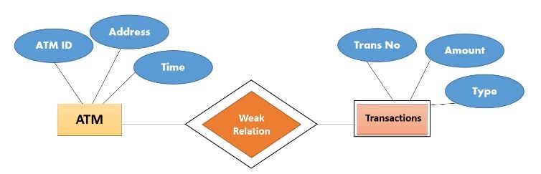
Entity Relationship Diagrams
Entity-Relationship Diagram (ERD) is a visual representation of different entities within a system and how they relate to each other.
Expressed in terms of:
Entities
Attributes
Relationships

Slide 3
Entity Relationship Diagrams
They are also known as ERD’s or ER models.
The purpose of an ERD is to capture the richest possible understanding of the meaning of data necessary for an information system or organization.
ERDs are made from Entities, Attributes, and Relations.

Slide 4
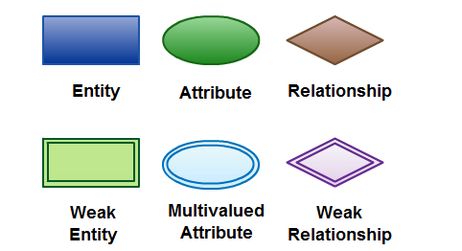
ER Diagram Symbols and Notations

Slide 5
Entity
An entity can be a person, place, event, or object that is relevant to a given system.
For example, a school system may include students, teachers, major courses, subjects, fees, and other items.
Entities are represented in ER diagrams by a rectangle and named using singular nouns.

Slide 6
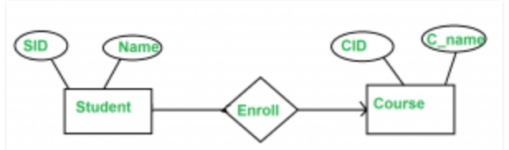
Entity

Slide 7
Attributes
An attribute is a property, trait, or characteristic of an entity, relationship, or another attribute.
An entity can have as many attributes as necessary. Meanwhile, attributes can also have their own specific attributes. For example, the attribute “customer address” can have the attributes number, street, city, and state. These are called composite attributes.
Note that some top level ER diagrams do not show attributes for the sake of simplicity. In those that do, however, attributes are represented by oval shapes.

Slide 8
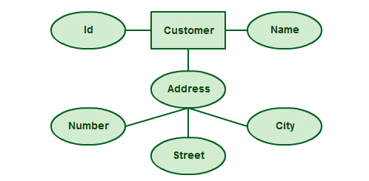
Attributes

Slide 9

Relationships
Relationships are associations between one or more entity types.
Relationships are the “glue” that holds together components of an E-R model.

Slide 10
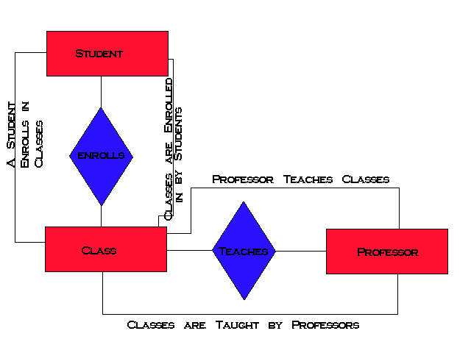
University Entity-Relationship Diagram
Relationship

Slide 11
Benefits of ER Diagrams
ER diagrams constitute a very useful framework for creating and manipulating databases.
ER diagrams are easy to understand and do not require a person to undergo extensive training to be able to work with it efficiently and accurately.
Database designers can use ER diagrams to easily communicate with developers, customers, and end users, regardless of their IT proficiency.

Slide 12
Benefits of ER Diagrams
ER diagrams are readily translatable into relational tables which can be used to quickly build databases.
ER diagrams may be applied in other contexts such as describing the different relationships and operations within an organization.

Slide 13


